Slide 1


JOURNAL APP
PRESENTED BY : Rahul Ranjan Prasad(1706147)
Sk Anirban(1706271)
Soumya Das(1706273)
YOUR
LOGO

Slide 2
Contents
01
Why Android Application?
02
Objective
03
Technology Used
04
UI & Data Flow
05
Methodology Used
07
Conclusion

Slide 3
Why Android Application ?
Open Software platform for mobile application development
Multiple Sales Channel
Customizable UI
Easy Adoption for developers

Slide 4
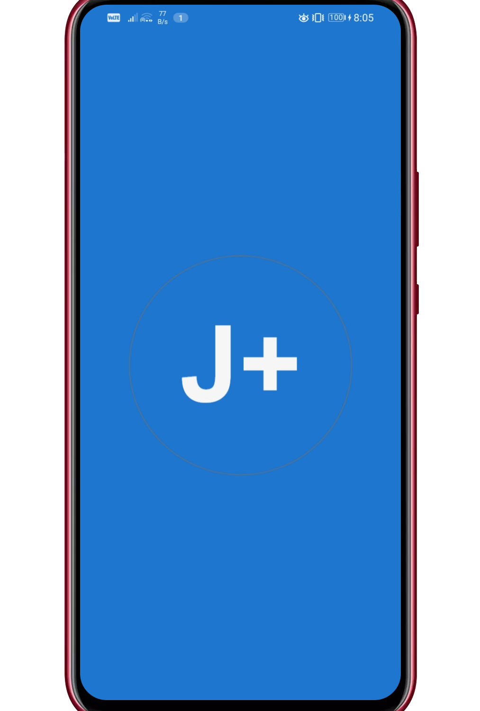
Objective
We are building a journal app for both official and un-official use for university activities, programs, seminars, etc. through which all the students and faculties are aware form university activities and get time to time information through this app because most of us not aware about what is going in our university. For that I and our team members take an initiative to build an Journal app for both purpose official and non-official use through which this problem resolve and for building this app we are using Android, Firebase, Various type of android library to build this app user friendly.

Slide 5
Technology Used
Android Studio 3.6.2
Firebase Firestore – Real Time Database
Adobe XD

Slide 6
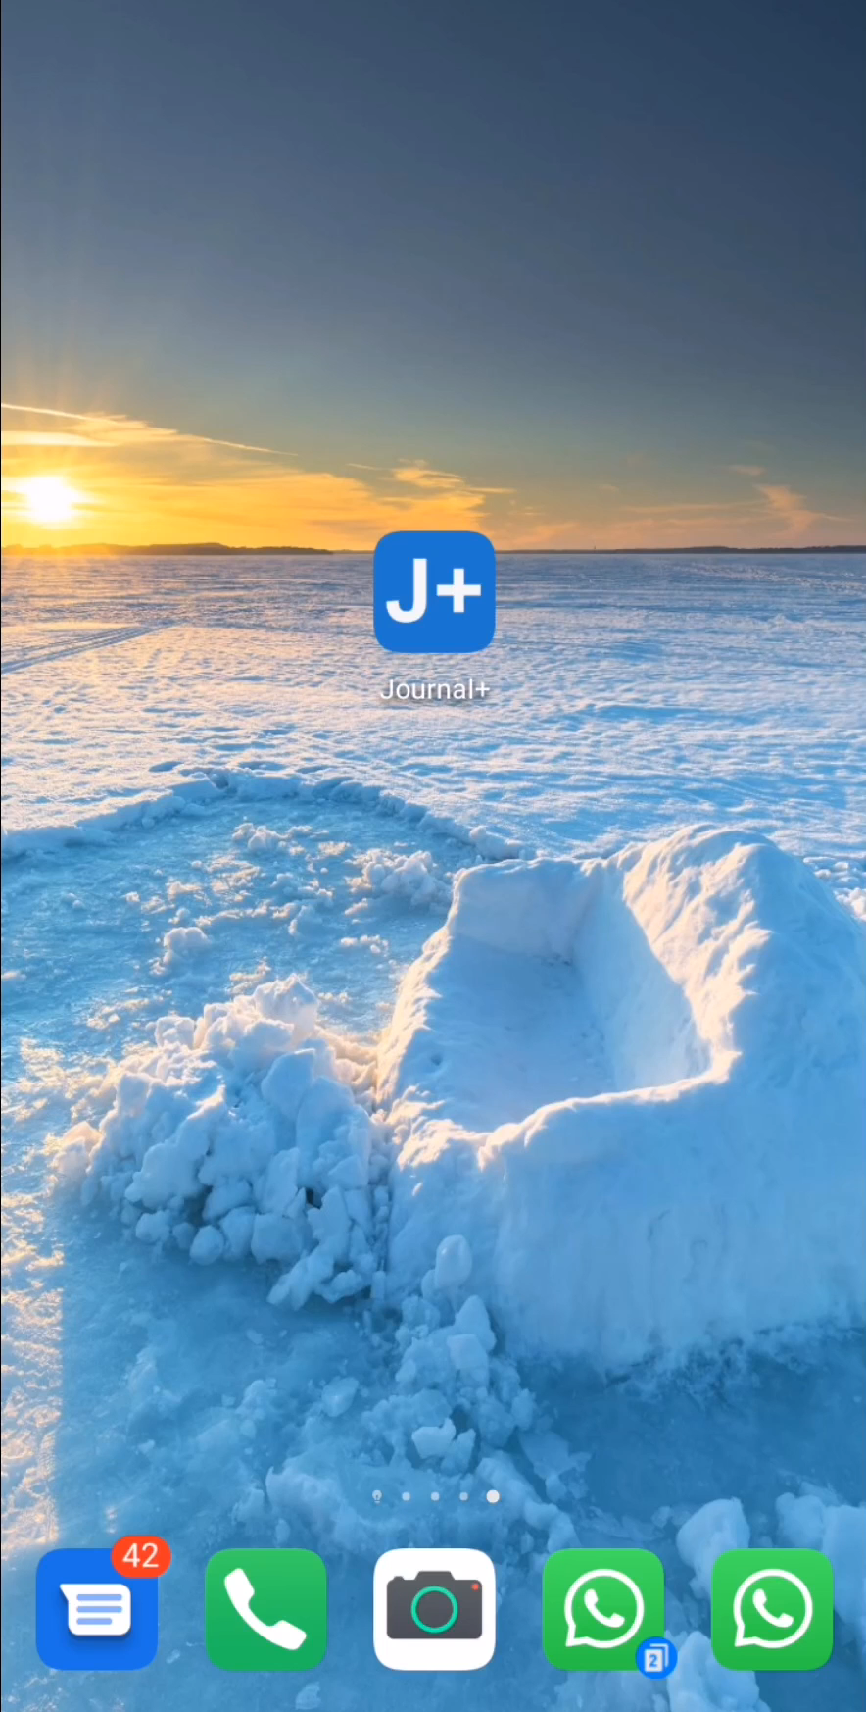
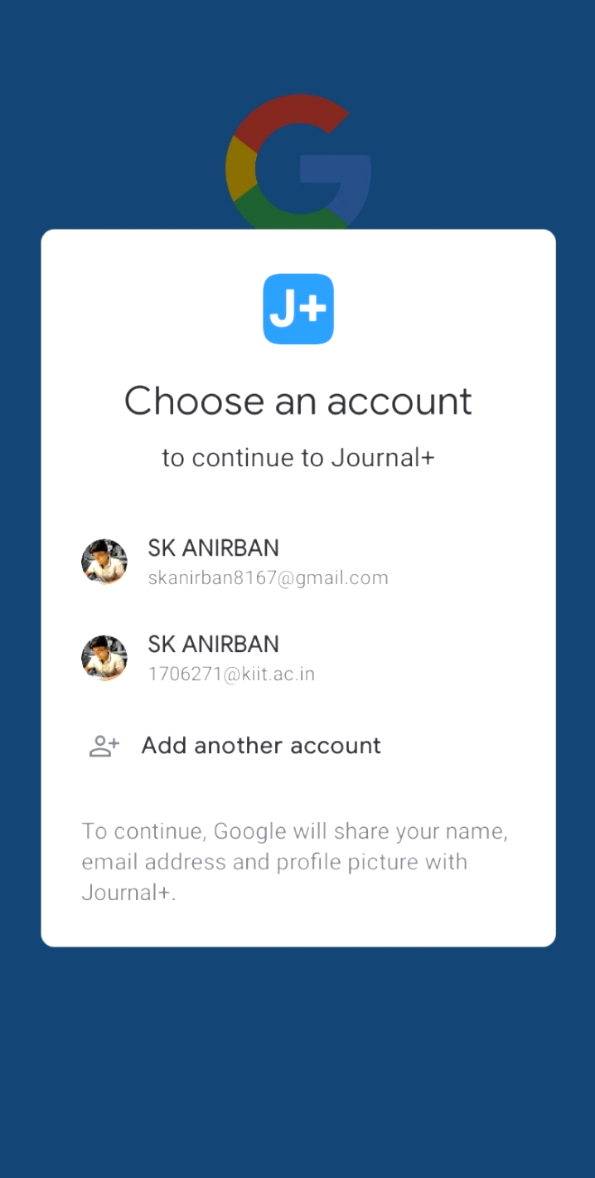
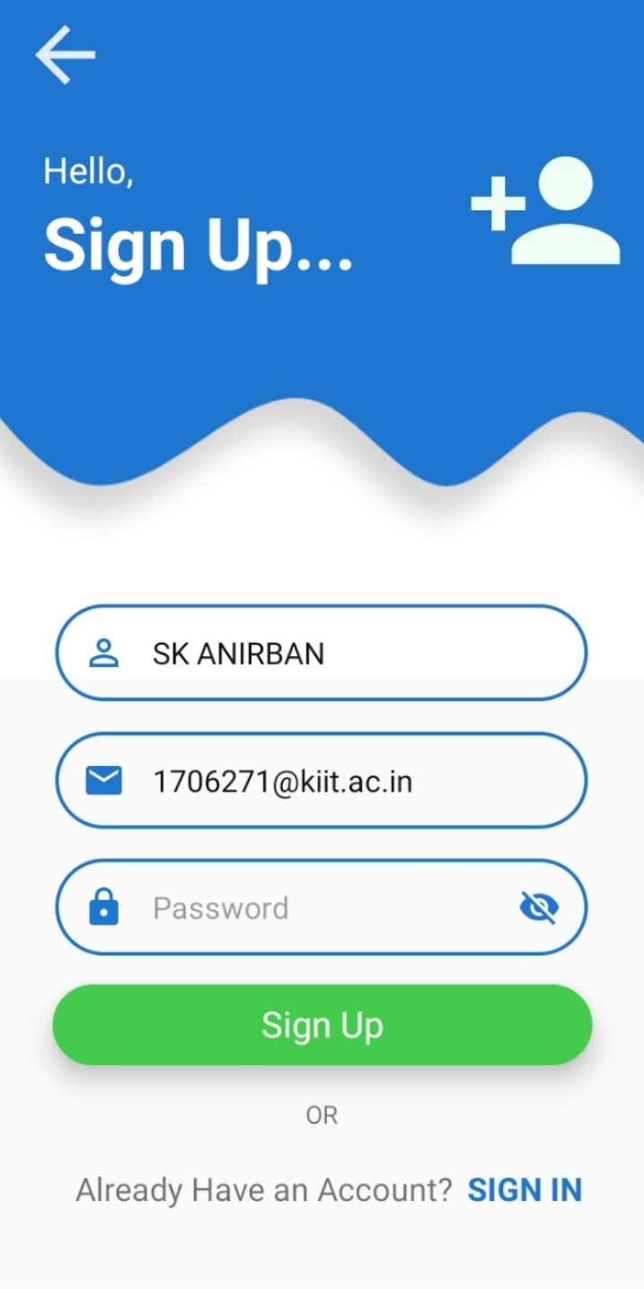
UI & Data Flow for Student User
Login Screen
Sign-up With Google
Sign Up Screen
Sign Up Button
Choose Account

Slide 7
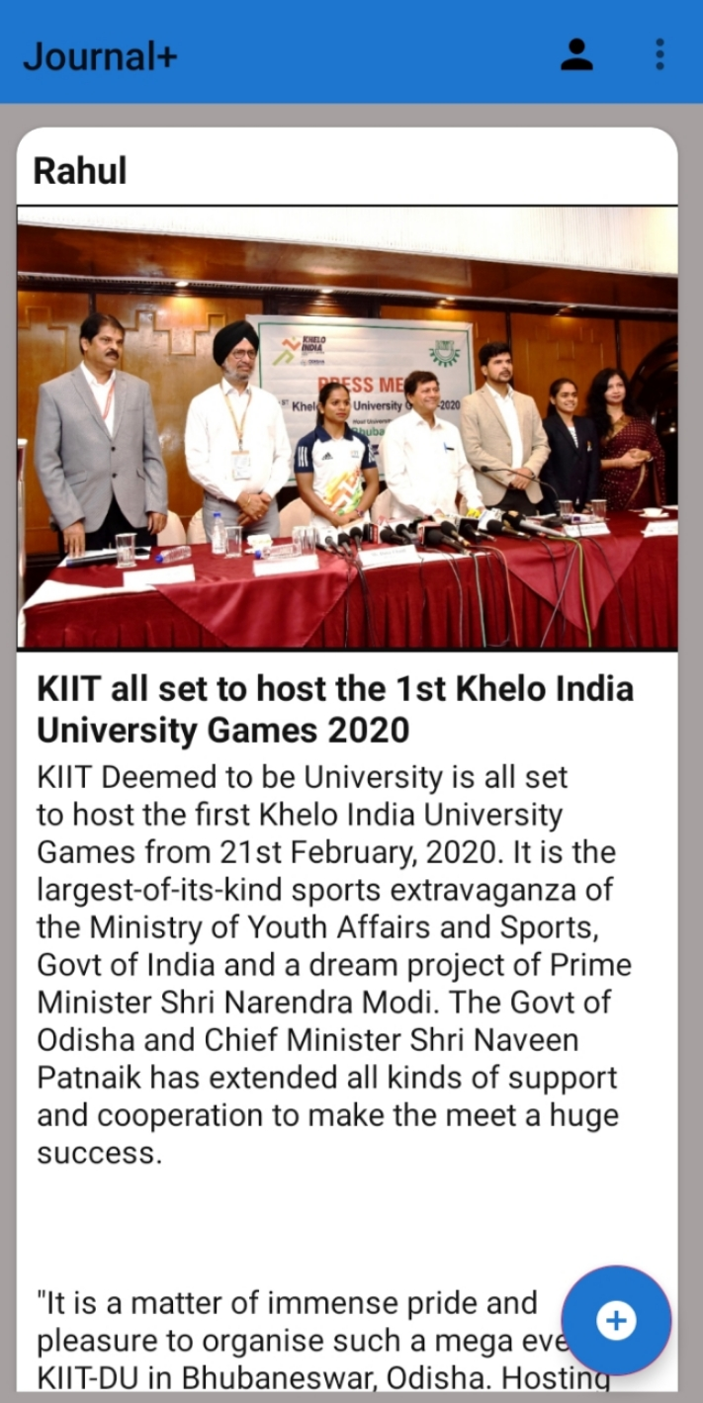
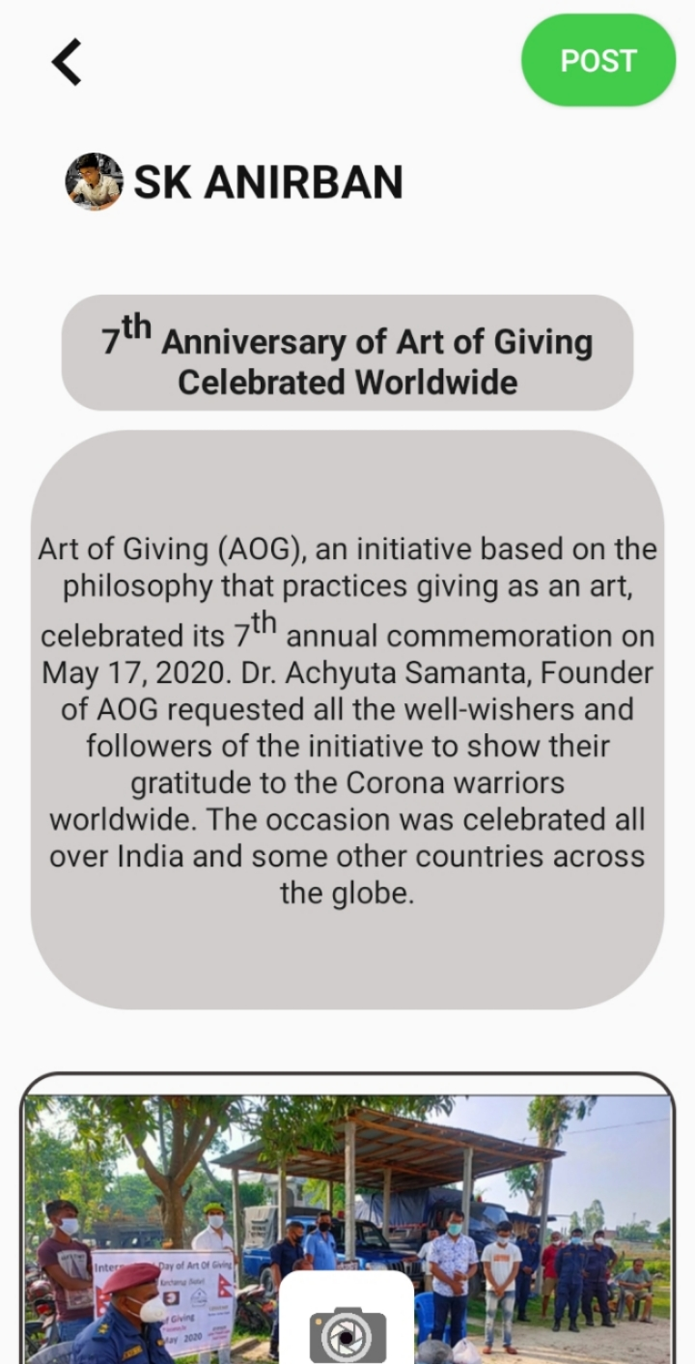
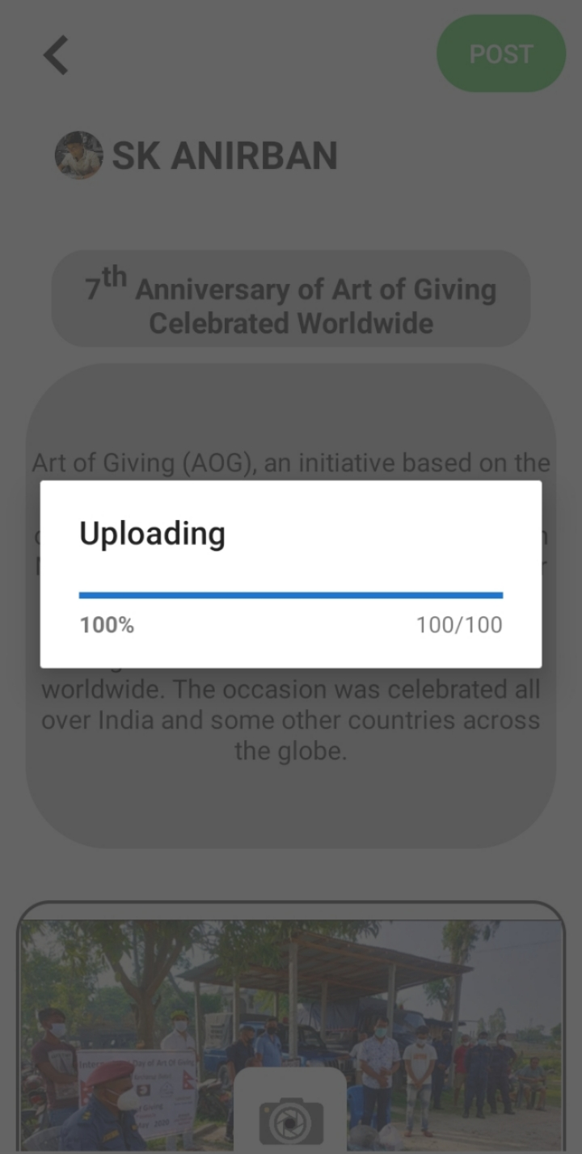
UI & Data Flow for Student User
Journal List
Add Journal
Uploading Screen
Add Button
Post

Slide 8
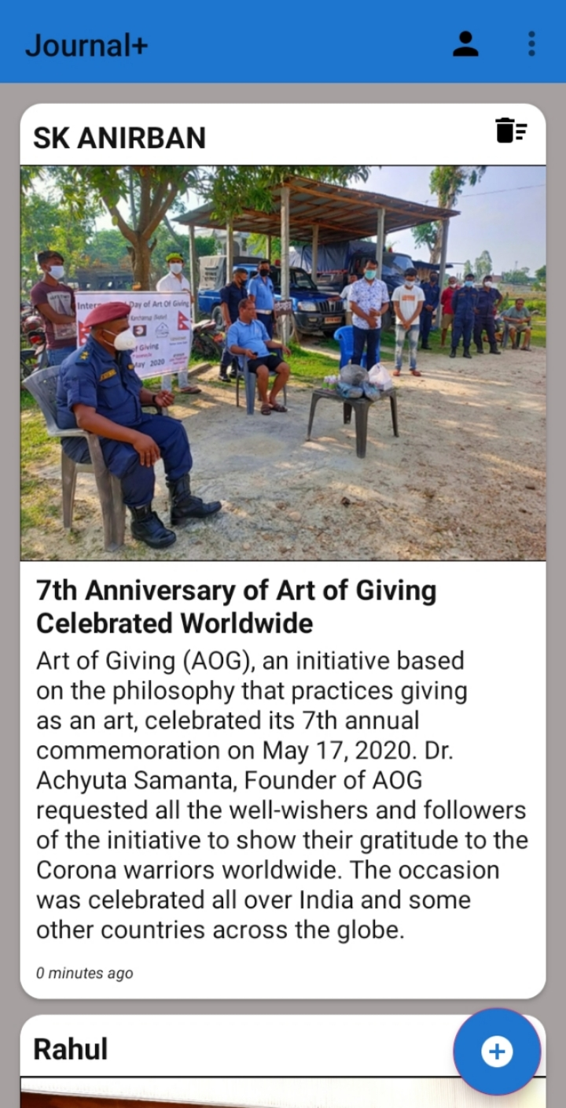
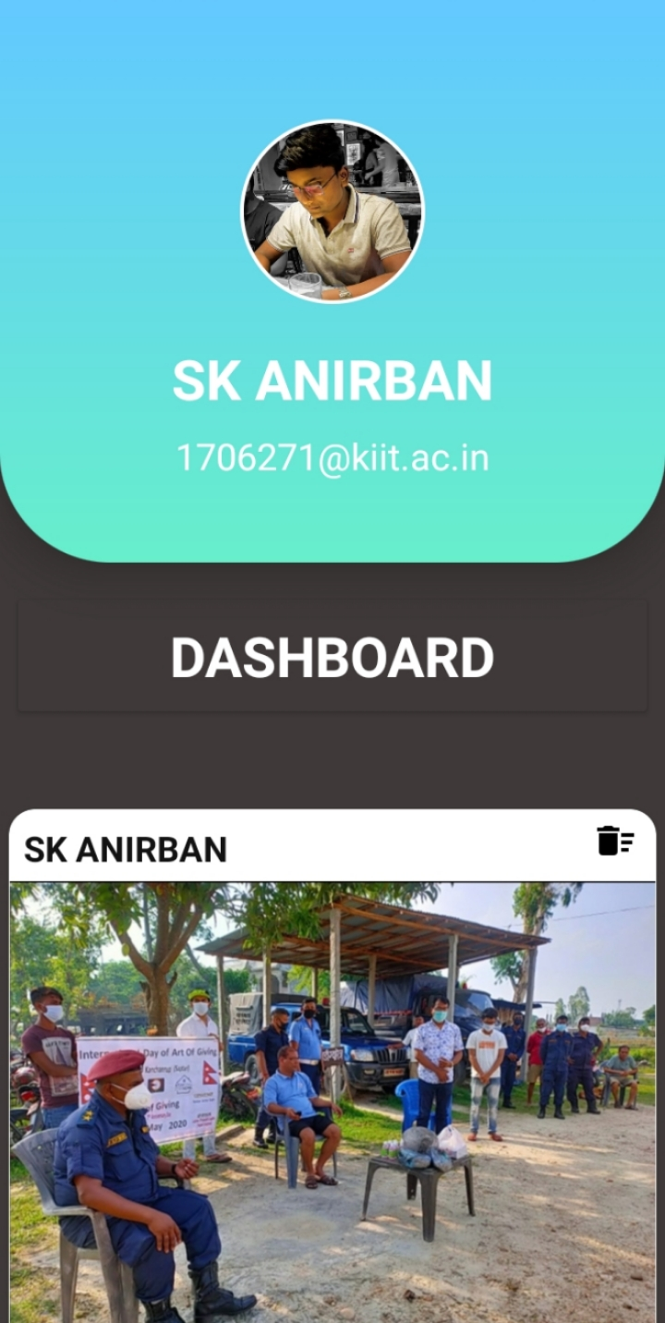
UI & Data Flow for Student User
Journal List
Profile
Journal List
Profile
Delete

Slide 9
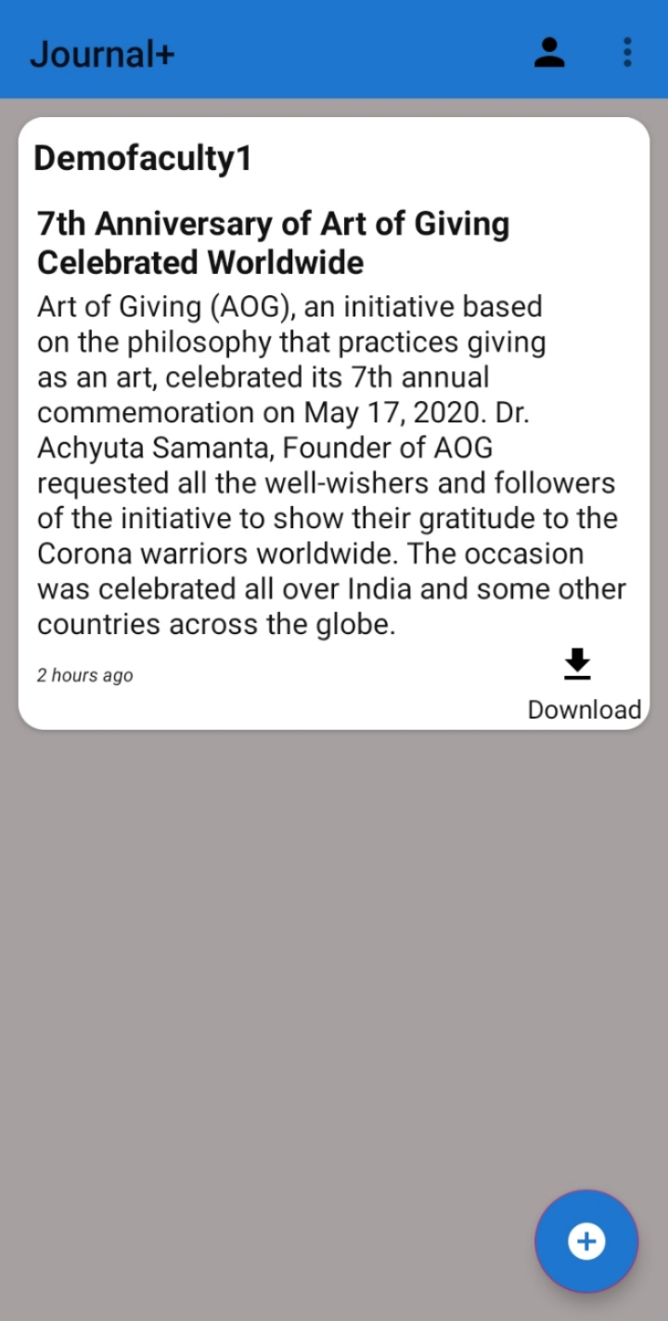
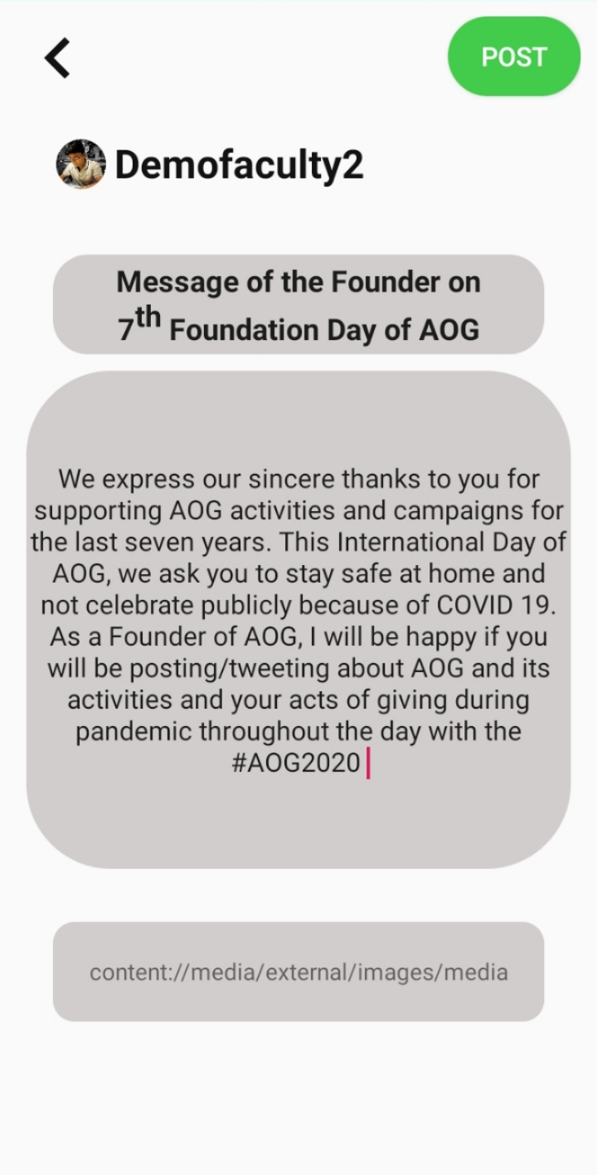
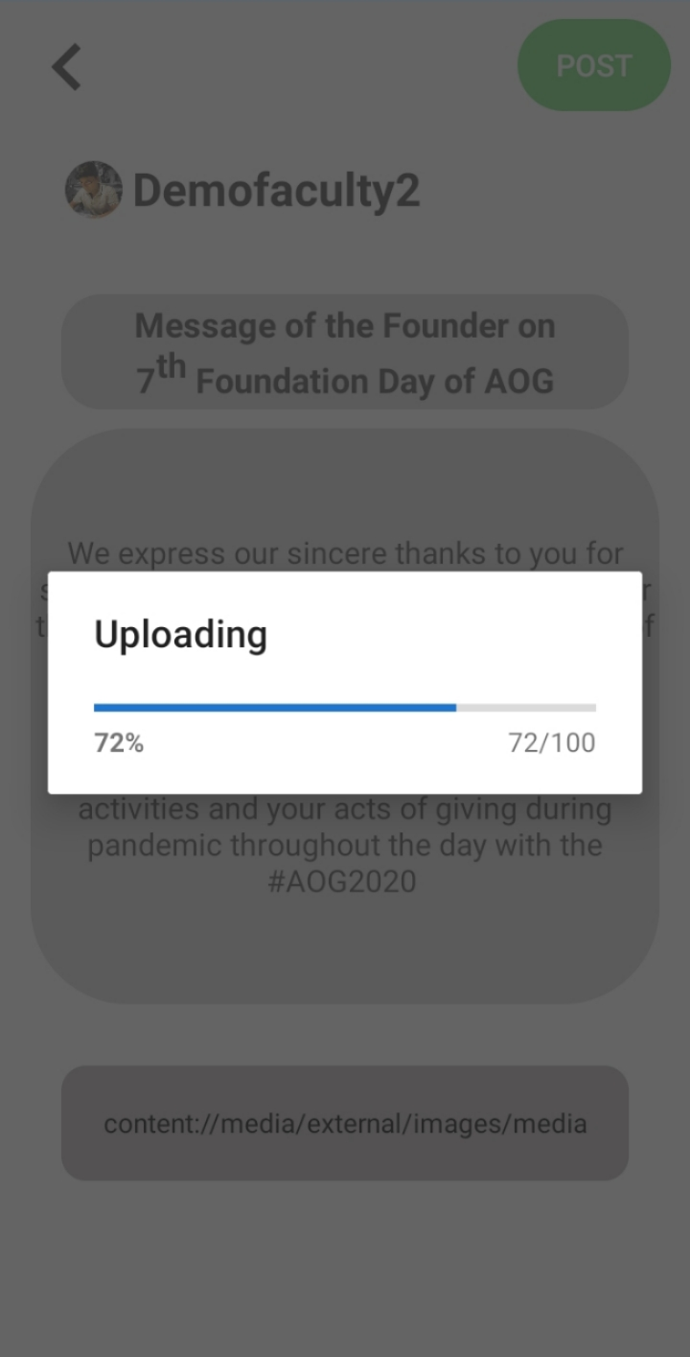
UI & Data Flow for Faculty User
Journal List
Add Journal
Uploading Screen
Add Button
Post

Slide 10
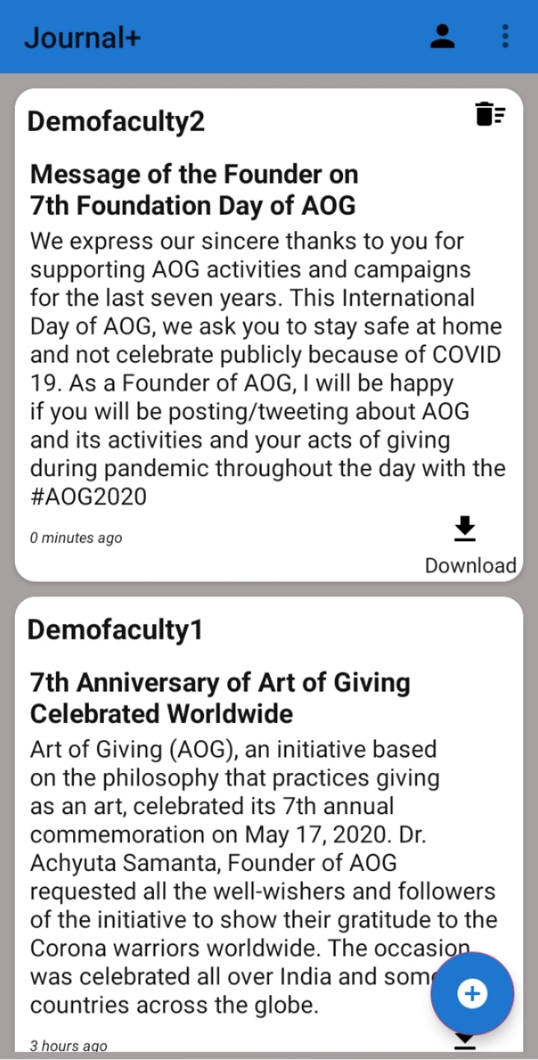
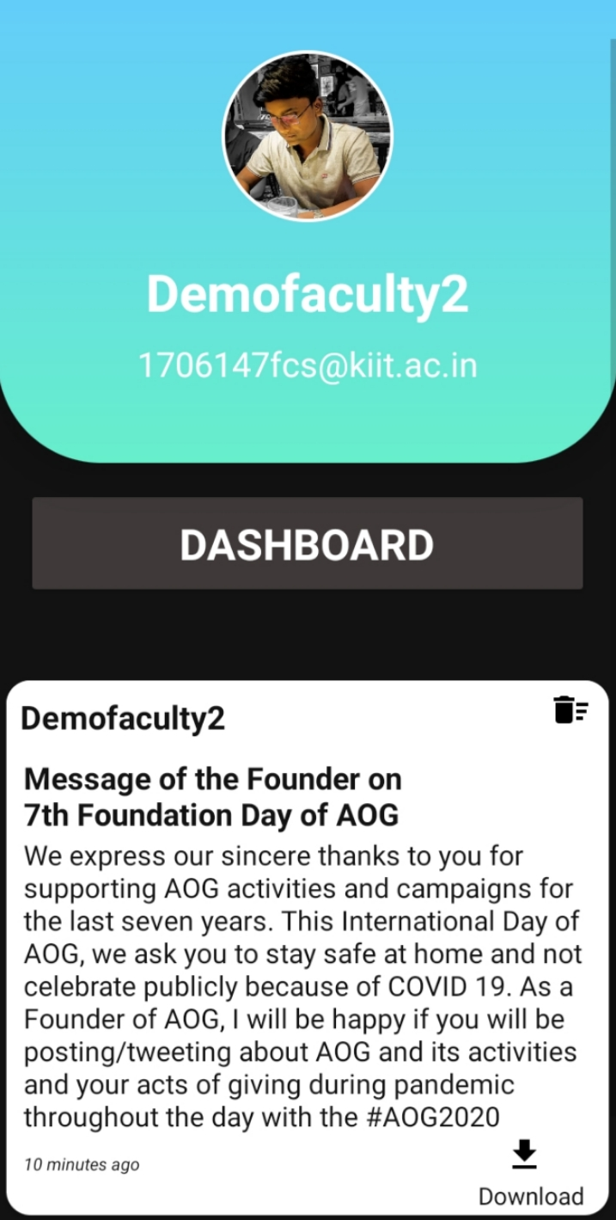
UI & Data Flow for Faculty User
Journal List
Profile
Journal List
Profile
Delete

Slide 11
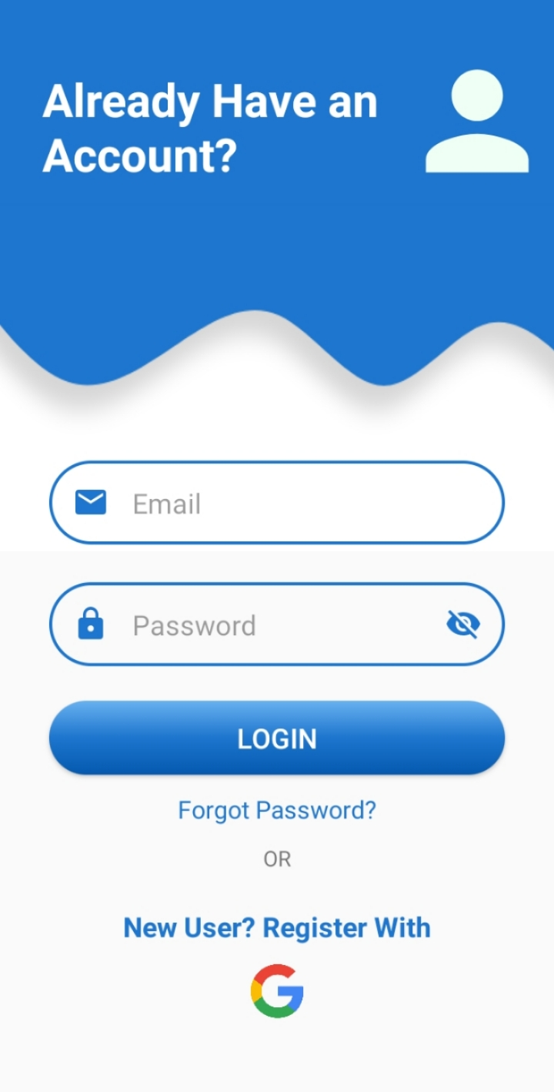
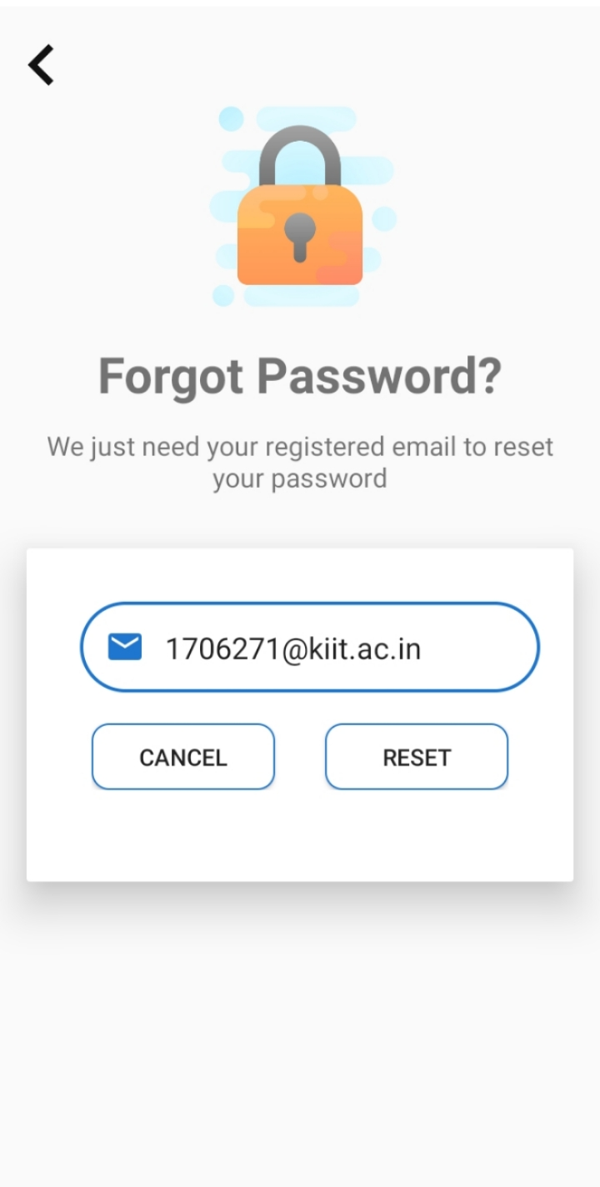
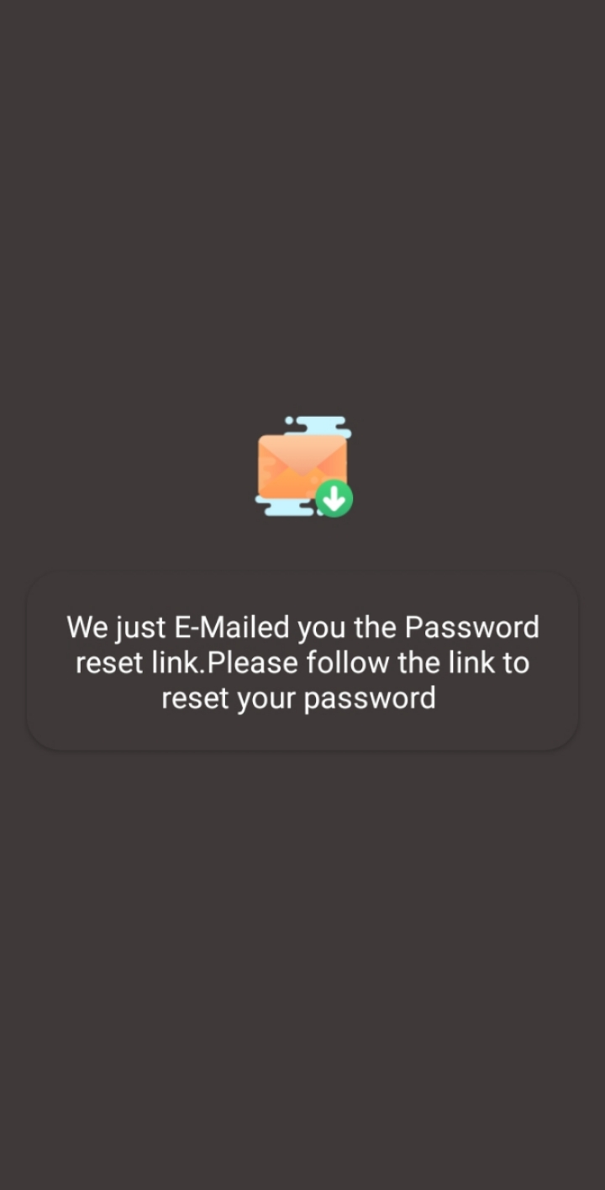
UI & Data Flow for All User
Log in
Reset Password
Link Sent
Forgot Password
Reset

Slide 12
Data Flow Diagram
Reset Password
Forgot password?
App Launch
Log in
Old user
New user
Sign up
Journal List
Add Journal
Profile

Slide 13
METHODOLOGY USED TO ANALYZE THE PROBLEM:-
1.Dexter:-
Dexter is an Android library that simplifies the process of requesting permissions at runtime.
Android Marshmallow includes a new functionality to let users grant or deny permissions when running an app instead of granting them all when installing it. This approach gives the user more control over applications but requires developers to add lots of code to support it.
The official API is heavily coupled with the Activity class. Dexter frees your permission code from your activities and lets you write that logic anywhere you want.
2.Circle Image View:-
A first circular Image View perfect for profile images. This is based on Rounded Image View from Vince Mi which itself is based on techniques recommended by Romain Guy.
It uses a Bitmap Shader and does not:-
1. Create a copy of the original bitmap.
2. Use a clip Path (which is neither hardware accelerated nor anti-aliased).
3. Use set Xfermode to clip the bitmap (which means drawing twice to the canvas).
As this is just a custom a custom Image View and not a custom Drawable or
combination or both it can be used with all kinds of drawable , i.e. a Picasso or
other non-standard drawable (needs some testing though).

Slide 14
3. Custom Google Sign In Button:-
A custom Sign In Button for android that supports android: text, currently not
supported by Google’s original Sign In Button. This library also allows to set
button theme to dark or light and is based on Google guidelines
4. Animatoo:-
Bored with the same animation for activity transition? Animatoo is the lightweight and easy to use Android
library that provides many activity transition animation.
5. Picasso:-
A powerful image downloading and caching library for Android.
6. Submit Button:-
It's a submit button with a fun animation for Android and also it’s a practical, cool & elegant
Submit Button. Here we can use custom color for our specific button and we can customize our button
7. Android-Spin Kit:-
This is Android loading animations or we can say customized progress bar.

Slide 15
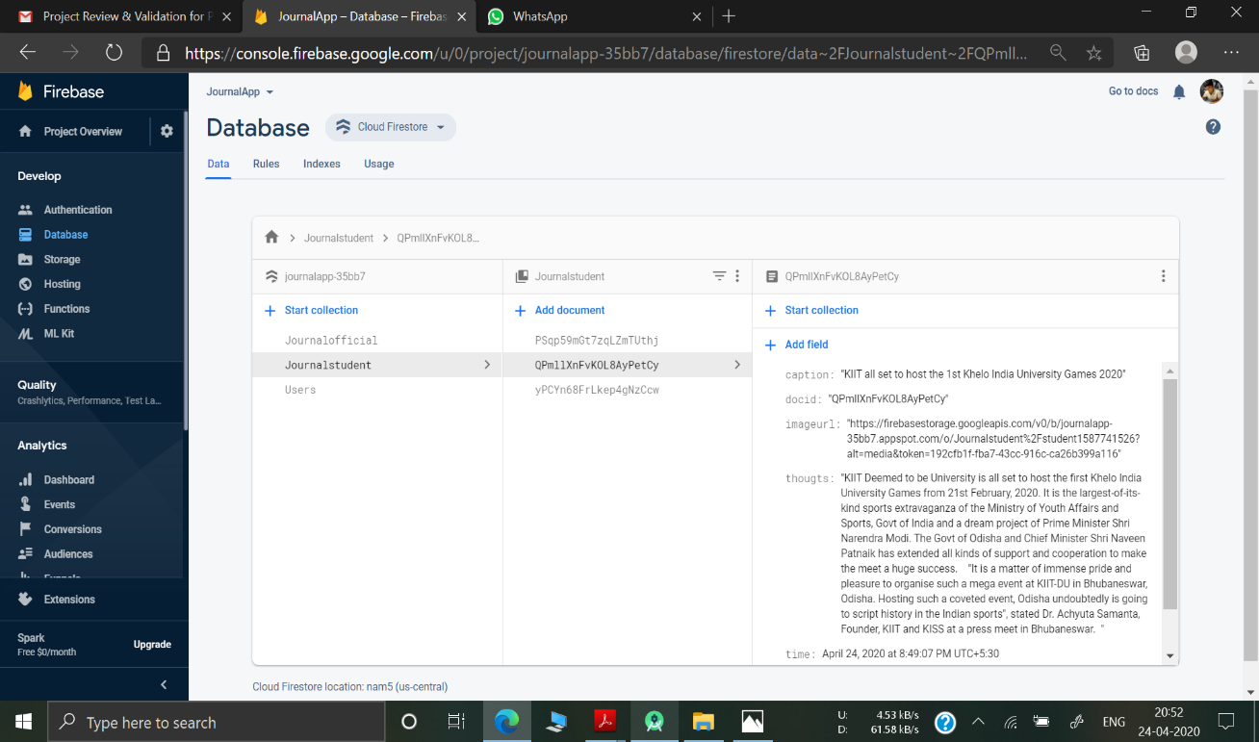
8. Firebase:-
Firebase is a Backend-as-a-Service — BaaS — and grew up into a next-generation app-development
platform on Google Cloud Platform. Firebase frees developers to focus crafting fantastic user
experiences. You don’t need to manage servers. You don’t need to write APIs. Firebase is your server,
your API and your data store, all written so generically that you can modify it to suit most needs.

Slide 16
CONCLUSION
This project surely helped us a lot to gain knowledge in the fields which we have had only heard about and never worked omit. For successful completion of this project the domains such as Android app development, database management and creation using firebase,
concepts of advanced java language and relevant libraries and basics of Software Engineering played a vital role . As mentioned earlier our objective through this piece of work is to gain knowledge about the various aspects of Mobile App Development using Android Studio and the other relevant technologies and algorithms that are used for the completion of our project. Future works involves the improvements of the app developed in this project by acquiring more knowledge in the relevant technologies that are used and also by getting the users feedback so that we can make the app more user-friendly in our future updates.

Slide 17
THANK YOU

